Slide 1

FinTech Guardian
Cloud-Native Real-Time Fraud Detection Platform
REACT FIREBASE GEMINI AI

Slide 2

The Enterprise Challenge
Why traditional banking systems fail in the modern era of high-frequency digital transactions.

Slide 3


From Reactive to Proactive
The Problem
The Solution
Enterprise banks process millions of transactions daily. Manual review is impossible, and traditional batch-processing (overnight checks) is too slow to stop fraud before the money leaves the system.
FinTech Guardian implements Event-Driven Architecture. By analyzing data streams in real-time using Edge AI, we can flag and block suspicious activity milliseconds after it occurs.

Slide 4







Core Architecture Pillars
Real-Time Ingestion
Serverless Scale
Cognitive Analysis
High-throughput data streaming utilizing React state management to simulate live enterprise transaction volumes.
Built on Google Firebase (Firestore) to auto-scale database read/writes without managing physical infrastructure.
A hybrid AI model combining fast statistical heuristics with deep-dive reasoning via Google Gemini 2.5.

Slide 5
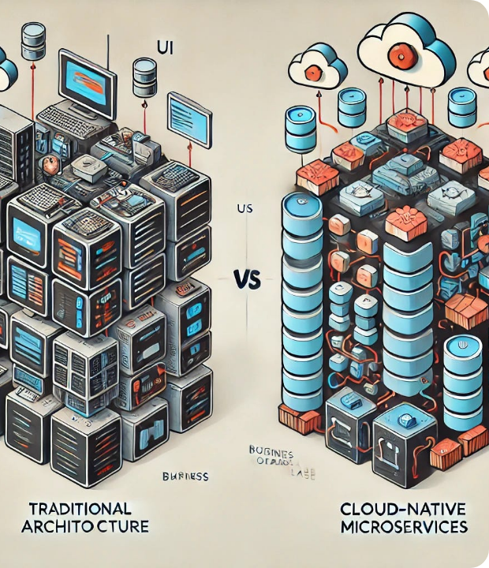
System Architecture
Decoupled Microservices
The application follows a modern microservices pattern. The Frontend (React) acts as both the ingestion engine and the visualization layer.
The Backend (Firebase) serves as a serverless data store, triggering real-time listeners (`onSnapshot`) to update the UI instantly without page refreshes.
This ensures zero latency between a fraud event occurring and the alert appearing on the dashboard.

Slide 6


The Hybrid AI Engine
2. Google Gemini (Accuracy)
1. Edge Heuristics (Speed)
For complex cases, we utilize the Gemini 2.5 Flash API. It analyzes context (e.g., "Why would a coffee shop charge $5,000?") to reduce false positives.
Running directly in the browser, our `FraudInferenceEngine` calculates Z-Scores and checks velocity rules in < 10ms.
•
Statistical Outlier Detection
•
Velocity Checks
•
IP Geolocation Validation

Slide 7


Live Visualization Layer
The dashboard provides operational visibility for risk teams. Key components include:
•
Live Feed: A scrolling log of transactions color-coded by risk level.
•
Dynamic Charts: Recharts integration visualizing volume vs. risk spikes.
•
Simulator: A manual injection tool allowing analysts to test "what-if" fraud scenarios against the AI.

Slide 8
Performance Metrics
1.5s
<50ms
99%
Ingestion Interval
Inference Latency
System Uptime

Slide 9




Development Roadmap
MVP Launch
AI Integration
Hardening
Scale
React Frontend & Firebase Integration
Edge Heuristics & Gemini API connection
Auth Rules & Enterprise Security
Multi-Region Deployment

Slide 10
Questions?
FinTech Guardian Project Team

Slide 11




Image Sources
https://miro.medium.com/0*QcJrecqBnA_k7siE
Source: medium.com
https://png.pngtree.com/background/20250820/original/pngtree-artificial-intelligence-brain-with-glowing-neural-network-connections-on-dark-futuristic-picture-image_17036210.jpg
Source: pngtree.com
https://png.pngtree.com/thumb_back/fh260/background/20250306/pngtree-futuristic-digital-dashboard-with-real-time-data-analytics-and-visualizations-symbolizing-image_17075747.jpg
Source: pngtree.com

